Slide 1




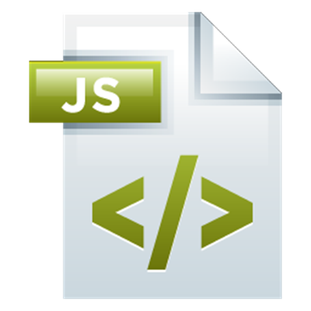
Templating
Creating UI elements
with Handlebars
Templating
SoftUni Team
Technical Trainers
Software University
http://softuni.bg

Slide 2



Table of Contents
Templating Concepts
Simple Templating
Templating Engines
Handlebars Overview
Examples

Slide 3
Have a Question?
sli.do #JSAPPS

Slide 4
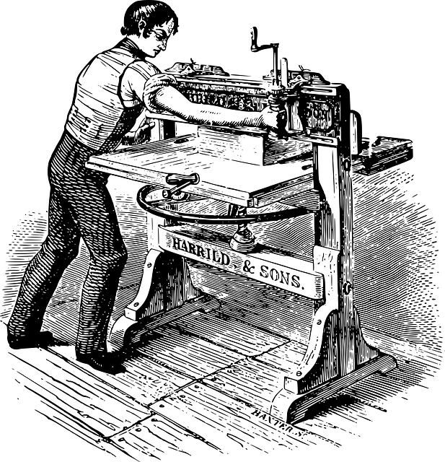
Templating Concepts
Definition and Uses

Slide 5
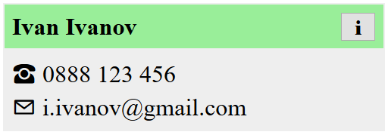

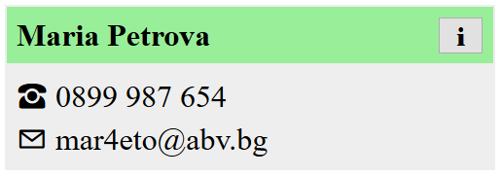
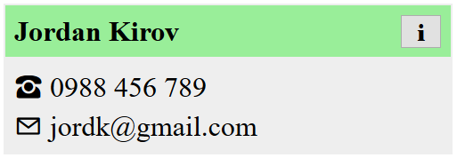
What is Templating?
Templates allow similar content to be replicated in a web page, without repeating the corresponding markup everywhere
HTML
<div>
<span>
<button>
Templating Engine
Dynamic Content
Ivan,
Maria,
Jordan, …

Slide 6
Templating Concepts
The static parts of a webpage are stored as templates
The dynamic content is kept separately (e.g. in a database)
A templating engine combines the two
Benefits:
Productivity – avoid writing the same markup over and over
Save bandwidth – send the HTML once, fill in any content
Composability – a single element can be used on multiple pages

Slide 7



Examples
Display articles in a blog
Template
Templating Engine
Content

Slide 8
Examples
Display articles in a blog
Display a gallery of photos
Template
Templating Engine
Content

Slide 9
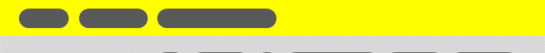
Examples
Display articles in a blog
Display a gallery of photos
Visualize user profiles
Template
Templating Engine
Content

Slide 10

Examples
Display articles in a blog
Display a gallery of photos
Visualize user profiles
Show items in a catalog
Template
Templating Engine
Content

Slide 11

Live Demo
Simple HTML Templating

Slide 12



Templating Engines
Overview of Popular JS Libraries

Slide 13


Templating Engines
Pug
Vue
jQuery Templates
Underscore Templates
Mustache
Handlebars

Slide 14
Templating with Handlebars
Syntax and Examples

Slide 15
Overview
Based on the Mustache specification
Adds helper functions and nested context paths
Uses double curly brace notation {{ }}
<div class="entry">
<h1>{{ title }}</h1>
<div class="body">
{{ body }}
</div>
</div>
<div class="entry">
<h1>My New Post</h1>
<div class="body">
This is my first post!
</div>
</div>

Slide 16

Example
<script id="entry-template" type="text/x-handlebars-template">
<div class="entry">
<h1>{{title}}</h1>
<div class="body">{{body}}</div>
</div>
</script>
let source = $("#entry-template").html();
let template = Handlebars.compile(source);
let context = {
title: "My New Post",
body: "This is my first post!"
};
let html = template(context);
Compile the template
from a string
Populate with data

Slide 17
Installation
Download Handlebars using WebStorm's terminal
Or download from handlebarsjs.com
Browser builds will be located in
Use handlebars from an online CDN:
npm install --save handlebars
node_modules/handlebars/dist/
https://cdnjs.cloudflare.com/ajax/libs/handlebars.js/4.0.10/handlebars.min.js
Note: It's best if your project has a package.json file

Slide 18
Hello Handlebars
<!DOCTYPE html>
<head>
<meta charset="UTF-8">
<title>Hello Handlebars</title>
<!-- Include Handlebars distribution -->
</head>
<body>
<div id="app"></div>
<script>
let template = Handlebars.compile('<h1>Hello {{name}}</h1>');
let container = document.getElementById('app');
container.innerHTML = template({ name: 'Handlebars' });
</script>
</body>
</html>

Slide 19
Expressions
You can place your templates in a script element
Use type text/x-handlebars-template
Give the element an ID for easier use
Anything inside double curly braces {{ }} will be evaluated
Set the context by executing the template with an object
Named identifiers will be looked up in the object's properties
Handlebars supports conditional statements and other helpers

Slide 20
Simple Identifiers
<script id="contact-template"
type="text/x-handlebars-template">
<article>
<div class="title">
{{name}}
<button>&#8505;</button>
</div>
<div class="info">
<span>&phone; {{phone}}</span>
<span>&#9993; {{email}}</span>
</div>
</article>
</script>

Slide 21
Compilation and Execution
Once loaded, a template must be compiled
Compiled templates are functions, that can be executed with whatever variables we need
let source = $("#contact-template").html();
let template = Handlebars.compile(source);
let context = {
name: 'Ivan Ivanov',
phone: '0888 123 456',
email: 'i.ivanov@gmail.com'
};
let html = template(context);

Slide 22
For-Loops
A template can be repeated for every entry in an array
let context = {
contacts: [
{ name: 'Ivan Ivanov', email: 'i.ivanov@gmail.com'},
{ name: 'Maria Petrova', email: 'mar4eto@abv.bg'},
{ name: 'Jordan Kirov', email: 'jordk@gmail.com'}
]};
<ul id="contacts">
{{#each contacts}}
<li>{{name}}: {{email}}</li>
{{/each}}
</ul>
The expression inside
the loop uses each
entry as context

Slide 23
Conditional Statements
Variable to check
for truthiness
{{#if sunny}}
The sky is clear
{{else}}
The sky is overcast
{{/if}}
<ul id="contacts">
{{#each contacts}}
<li>{{name}}: {{email}}</li>
{{else}}
<i>(empty)<i>
{{/each}}
</ul>
Will be shown if
the array is empty

Slide 24
Partials
Partials are templates that can be inserted into other templates
let source = $("#contact-template").html();
Handlebars.registerPartial('contact', source);
Partial name
Template as string
<div id="contacts">
{{#each contacts}}
{{> contact}}
{{else}}
<i>(empty)<i>
{{/each}}
</div>
Partials are
globally accessible

Slide 25
HTML Escaping
By default, any strings that are evaluated will be HTML-escaped
To prevent this, use the "triple-stash"
title: "All about <p> Tags"
body: "<p>This is a post about &lt;p&gt; tags</p>"
<div class="entry">
<h1>{{title}}</h1>
<div class="body">
{{{body}}}
</div>
</div>
<div class="entry">
<h1>All About &lt;p&gt; Tags</h1>
<div class="body">
<p>
This is a post about &lt;p&gt; tags
</p>
</div>
</div>

Slide 26
Live Demo
Templating with Handlebars

Slide 27
Precompiled Templates

Slide 28
Practice: Templating
Live Exercises in Class (Lab)

Slide 29


Summary
Templates speed up and simplify the development process
Handlebars offers effective templates and simple helper functions
<div class="entry">
<h1>{{ title }}</h1>
<div class="body">
{{ body }}
</div>
</div>
<div class="entry">
<h1>My New Post</h1>
<div class="body">
This is my first post!
</div>
</div>

Slide 30







Templating
https://softuni.bg/courses/

Slide 31
License
This course (slides, examples, demos, videos, homework, etc.) is licensed under the "Creative Commons Attribution-NonCommercial-ShareAlike 4.0 International" license

Slide 32





Free Trainings @ Software University
Software University Foundation – softuni.org
Software University – High-Quality Education, Profession and Job for Software Developers
softuni.bg
Software University @ Facebook
facebook.com/SoftwareUniversity
Software University Forums
forum.softuni.bg

